Slide 1
Marketplace for northwest Missouri
Place to buy and sell
DR. CHANDRA MOULI KOTTETI – Client/Mentor KIRAN KUMAR GUNDAPUNENI – Back End Developer
USHA PATI – Front End Developer SAJIDA MOHAMMAD – Front End developer
HARI KIRAN ALURI – Back End Developer

Slide 2

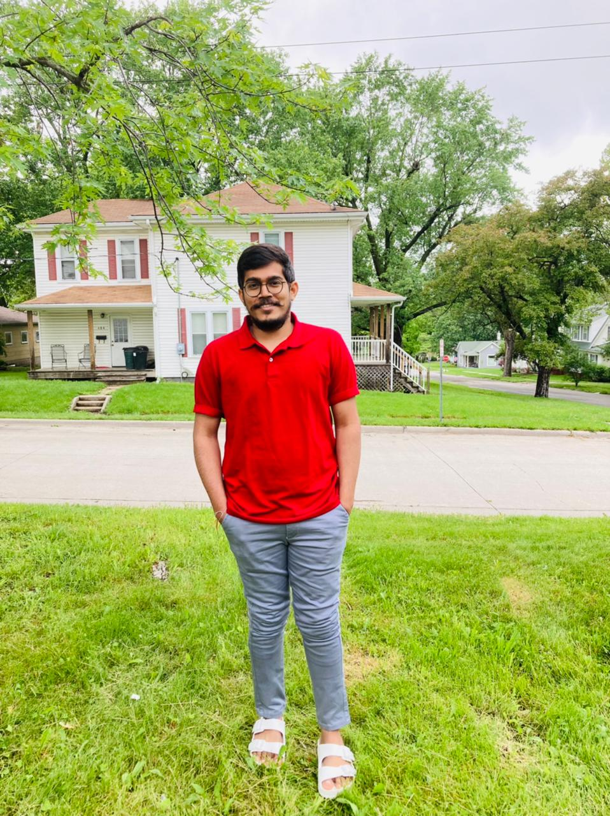



Team Members
DR.CHANDRA MOULI
KOTTETI
USHA PATI
KIRAN KUMAR GUNDAPUNENI
SAJIDA MOHAMMAD
HARI KIRAN ALURI

Slide 3
Table of Contents
AWS RDS
Budget Tracking
Amazon S3 Bucket
Console
Access Keys
AOP(Aspect Oriented Programming)
Terminologies
Postman
Kiran Gundapuneni

Slide 4


AWS – RDS
The database we used is a distributed relational database.
It can be accessed from anywhere with a single endpoint.
It can be hosted anywhere where AWS has its data center.
Kiran Gundapuneni

Slide 5




Set up
Connection Issues
Need to modify the security group and create permission for inbound rules and set outbound rules
Once the user modifies his security groups and allows traffic on his ports he can connect to the remote database from his local machine
Kiran Gundapuneni

Slide 6
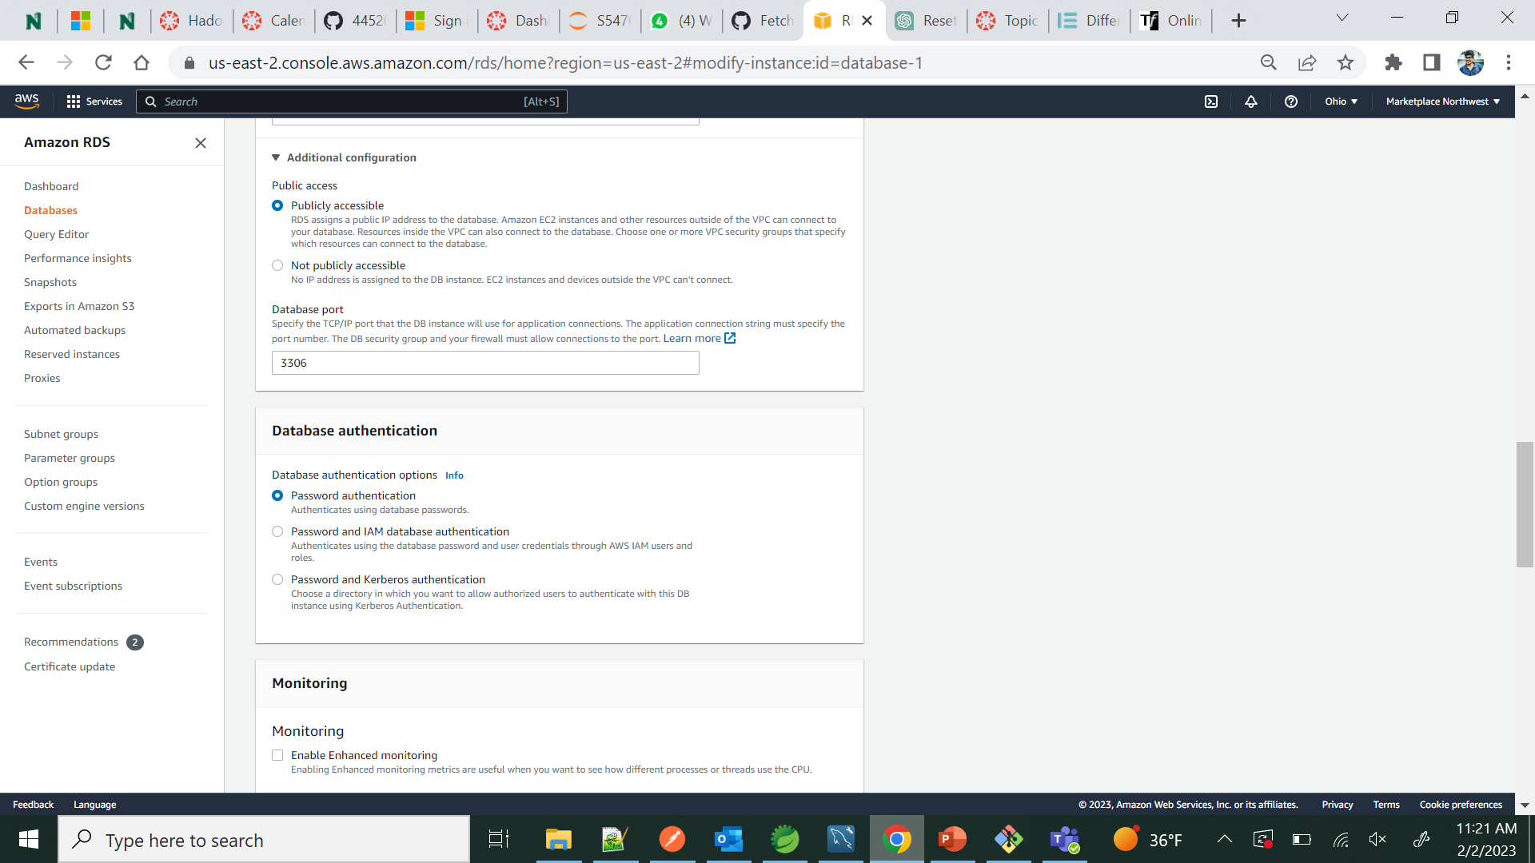
Accessibility
Fig 1.1. Accessibility
Kiran Gundapuneni

Slide 7
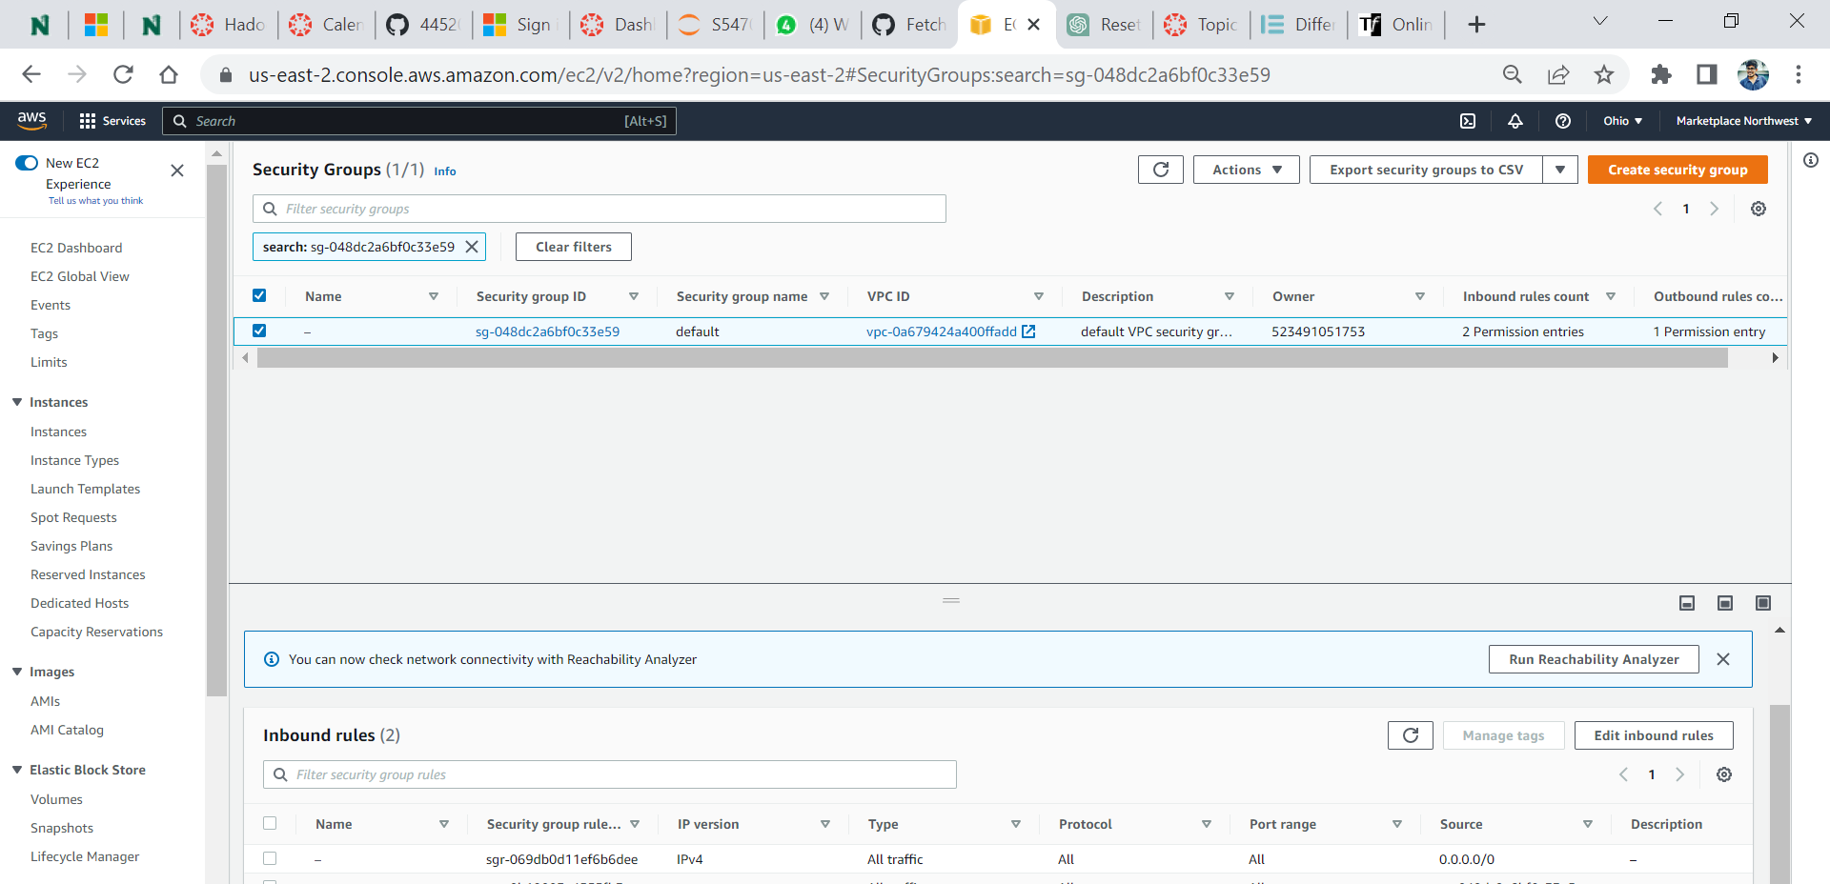
Security Group
Fig 1.2. Security Group
Kiran Gundapuneni

Slide 8
Budget tracking
Budget Tracking
Keep checking in AWS Billing→ AWS Free Tier
Create a preference to receive AWS Billing Alert Via e-mail to see the usage if it is exceeded.
Kiran Gundapuneni

Slide 9
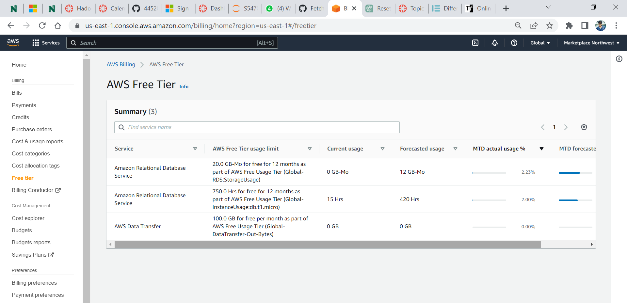
Free Tier
Fig 1.3. Free Tier
Kiran Gundapuneni

Slide 10

What is Amazon S3
Amazon Simple Storage Service (Amazon S3) is an object storage service.
Customers of all sizes and industries can use Amazon S3 to store and protect any amount of data.
Fig 2.1. Logo of Amazon S3
Usha Pati

Slide 11
How Amazon S3 works
To store data in Amazon S3, first create a bucket and specify a bucket name and AWS Region. Then, upload data to that bucket as objects in Amazon S3. Each object has a key (or key name), which is the unique identifier for the object within the bucket.
Buckets and the objects in them are private and can be accessed only if bucket owner explicitly grant access permissions.
The permissions attached to the bucket apply to all of the objects in the bucket that are owned by the bucket owner. Bucket policies are limited to 20 KB in size.
Usha Pati

Slide 12
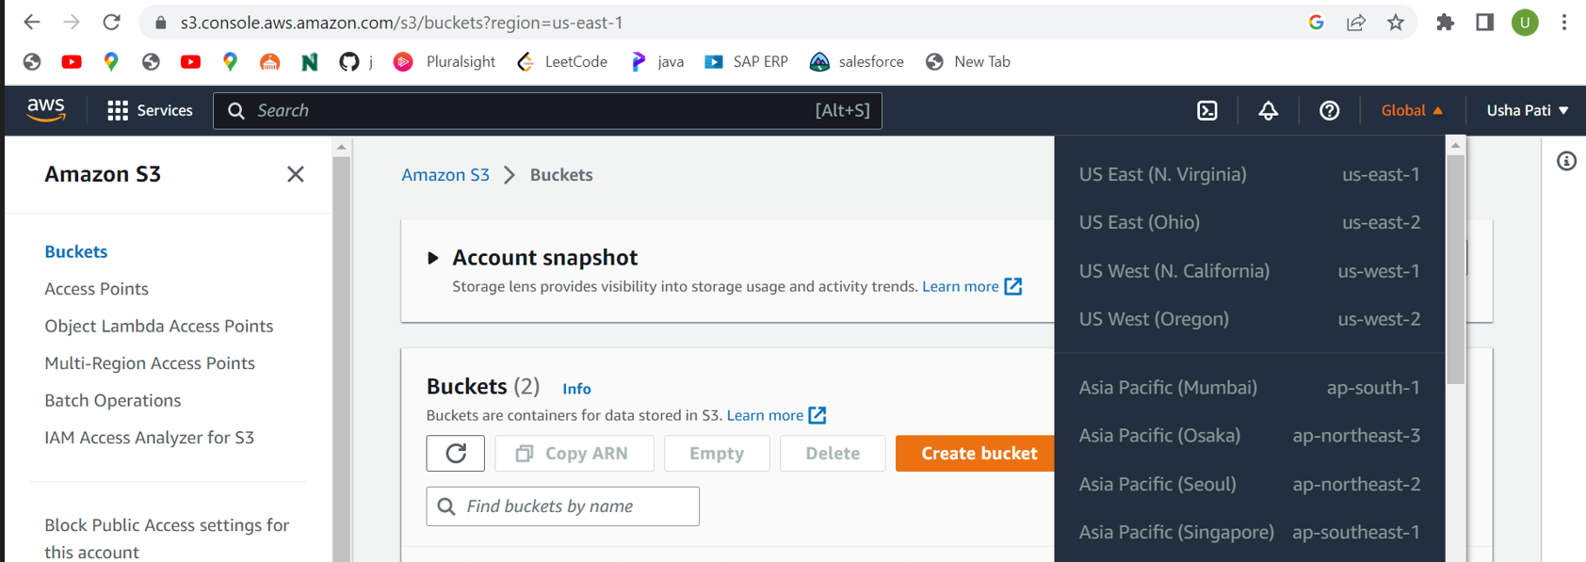
Amazon S3 console
Fig 2.2 Amazon S3 console
Usha Pati

Slide 13
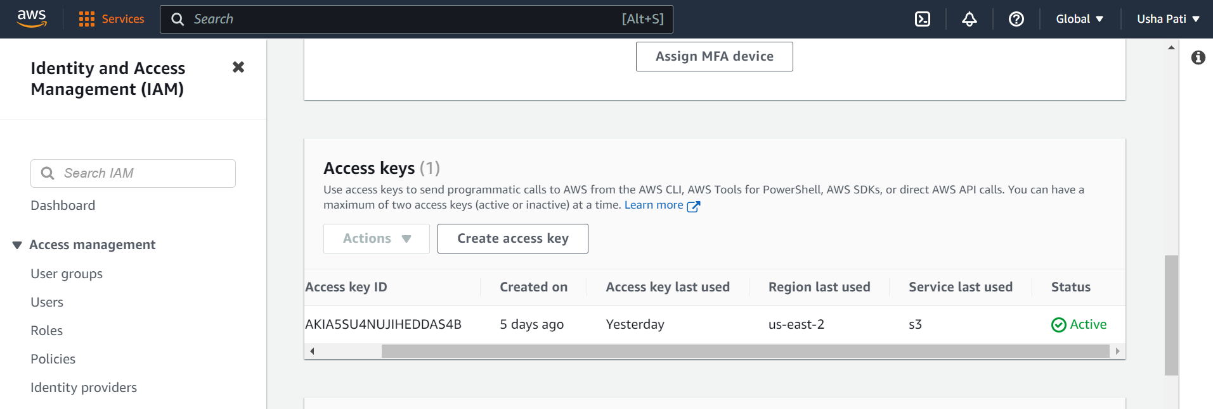
Managing Access Keys
Access keys are long-term credentials for an IAM user or the AWS account root user. You can use access keys to sign programmatic requests to AWS API.
Access key ID and secret access key together required to authenticate user requests.
Fig 2.3. IAM console
Usha Pati

Slide 14
AOP(Aspect Oriented Programming)
Complements the OOP
Key unit of modularity is Aspect
Add additional behavior to existing code without modification
Business modules contain code of primary concern
Sajida Mohammad

Slide 15
Examples of Aspects
Logging – Logs the useful information
Security – Provides security
Transaction – Used for making transactions
Sajida Mohammad

Slide 16
Terminologies
Aspect: Cross cutting concerns across different methods
Advice: Action taken by aspect at particular point. Includes Before and After actions
Point Cut: Helps Advice to be applied by an Aspect at a particular Join Point.
Sajida Mohammad

Slide 17
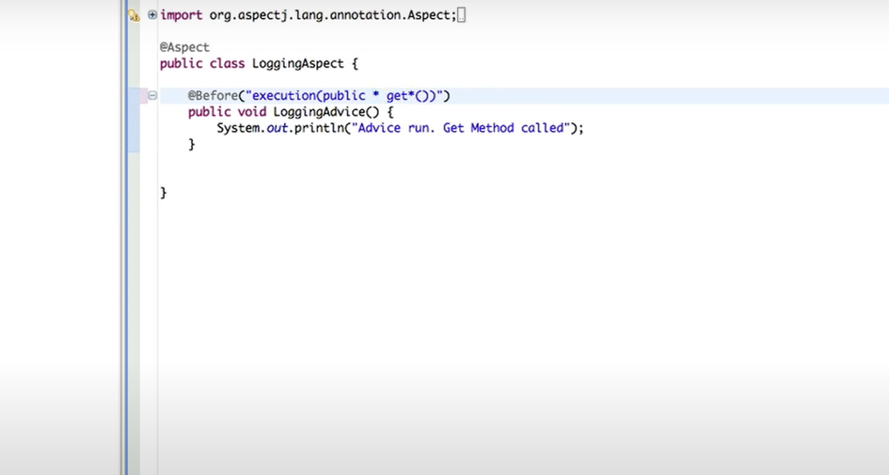
AOP Example
Fig 3. AOP Example
Sajida Mohammad

Slide 18
What's an API?
Application programming interface Allow services to communicates
with each other
software has become more complex and collaborative over the year developer no longer need to create every service from scratch
APIs allow developers to access data from a service (like Google or twitter) without any knowledge of how the codebase has been implemented
Hari Kiran Aluri

Slide 19
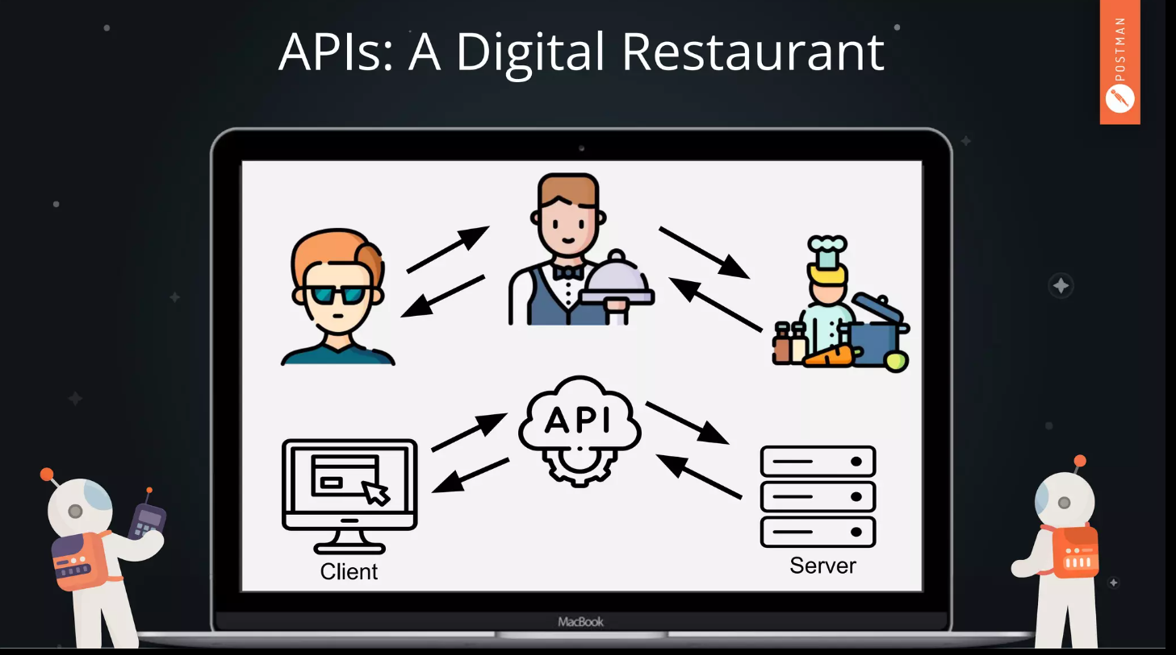
Fig 4.1 APIs Digital Restaurant
Hari Kiran Aluri

Slide 20
There's an API for everything
Youtube-to-MP3
Spotify
Twitter
Facebook
Google
Hari Kiran Aluri

Slide 21
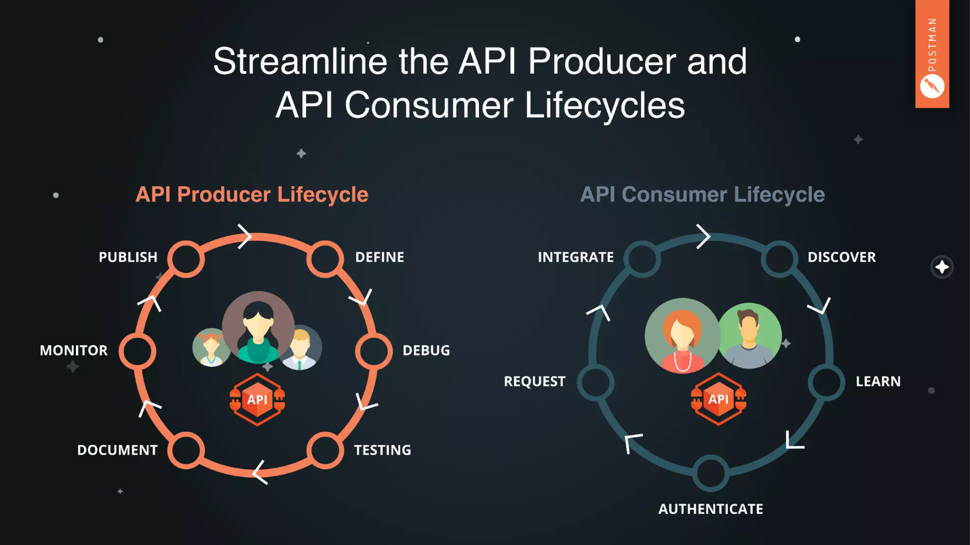
API Producer and API Consumer
FIg4.2 Shows Consumer and producer API's
Hari Kiran Aluri

Slide 22
What is Postman
Postman is a collaborative API development platform that simplifies creating using and testing APIs with UI
Hari Kiran Aluri

Slide 23
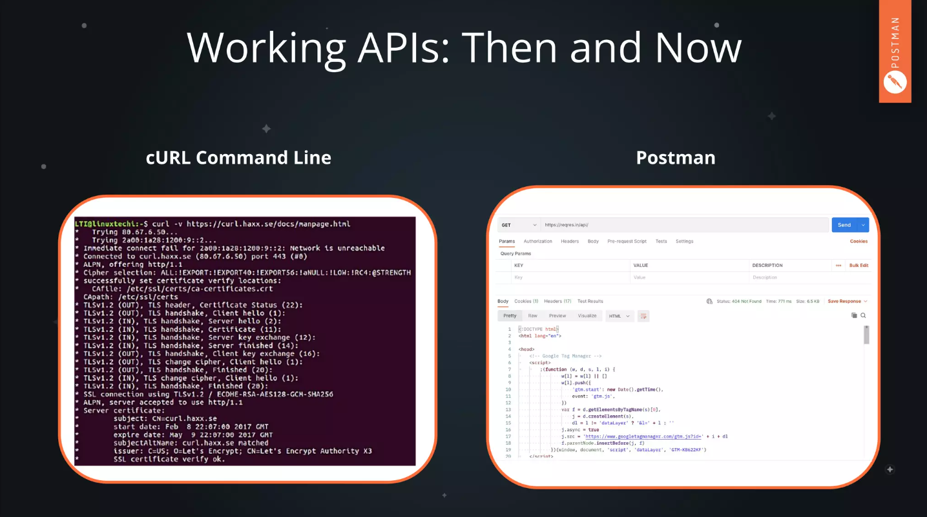
Fig 4.3 Shows how the request is made now and then
Hari Kiran Aluri

Slide 24
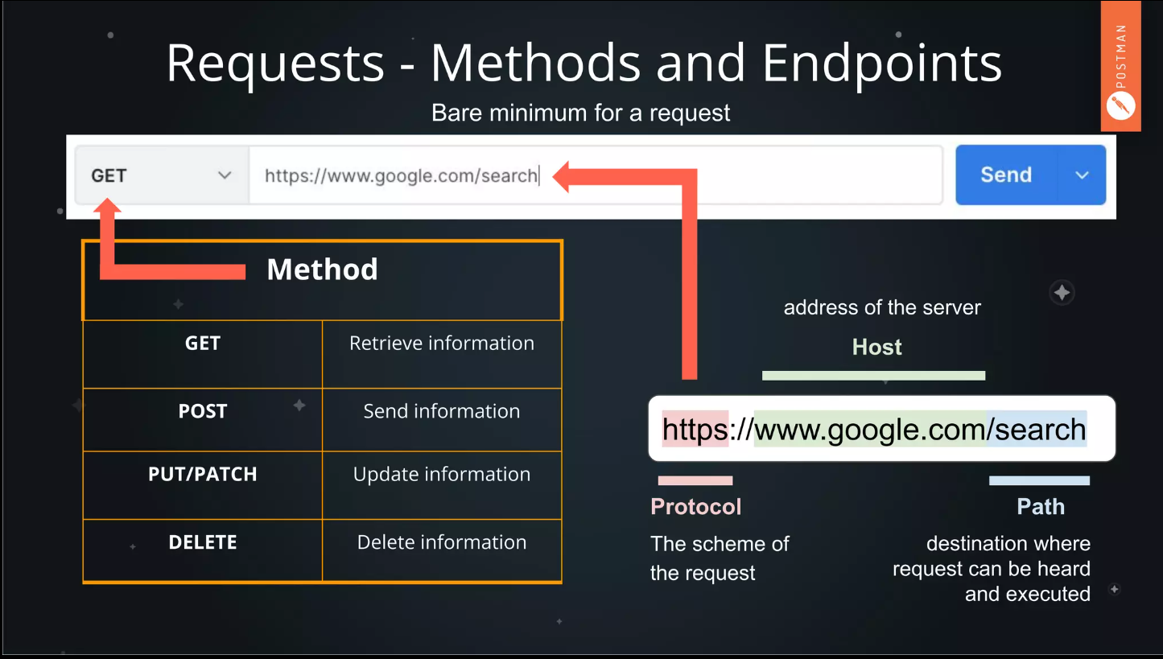
Making Requests
the three ingredients to make a request
1)Method(GET,POST)
2)Address/Endpoint(URL)
3)path
Fig4.3 Requests –Methods and Endpoints
Hari Kiran Aluri

Slide 25
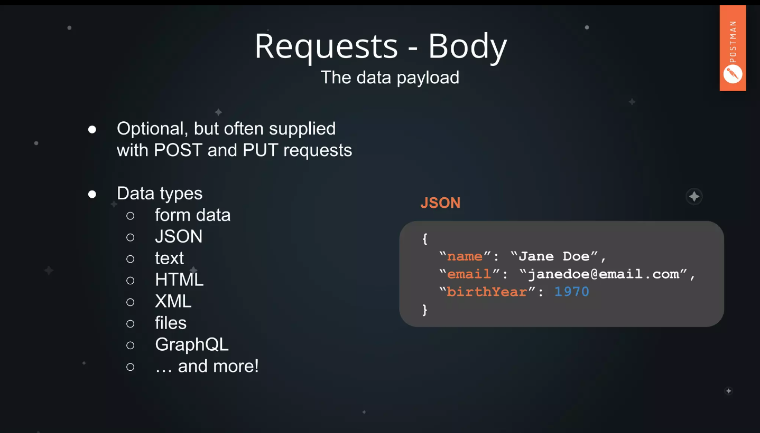
Fig 4.4 Hot to send the request Body
Hari Kiran Aluri

Slide 26
Response Elements
Status Codes(200 Ok,201 Created, 404 Not found)​
Headers​
Accessing body data
Hari Kiran Aluri

Slide 27
References
GitHub link : https://github.com/harichowdary-aluri/gdp_1-project
Amazon S3 creation guide : https://docs.aws.amazon.com/AmazonS3/latest/userguide/create-bucket-overview.html
S3 Logo: https://cdn-blog.lawrencemcdaniel.com/wp-content/uploads/2021/01/30083957/aws-s3-logo.png
RDS Creation: https://docs.aws.amazon.com/AmazonRDS/latest/UserGuide/CHAP_BestPractices.html
Hari Kiran Aluri

Slide 28
Team Members
DR.CHANDRA MOULI
KOTTETI
USHA PATI
KIRAN KUMAR GUNDAPUNENI
SAJIDA MOHAMMAD
HARI KIRAN ALURI

Slide 29


Slide 30
Marketplace for northwest Missouri
Place to buy and sell
DR. CHANDRA MOULI KOTTETI – Client/Mentor KIRAN KUMAR GUNDAPUNENI – Back End Developer
USHA PATI – Front End Developer SAJIDA MOHAMMAD – Front End developer
HARI KIRAN ALURI – Back End Developer

